Slide 1

POF
Performance Optimized Fluids

Slide 2

What is POF?
POF: Performance Optimized Fluids
POF is a stable algorithm implementing, testing and comparing system that can be used for anyone who is interested about fluid simulation areas.
What is NVIDIA Flex?
In our project, we used a particle-based fluid simulation published by NVIDIA company called Flex. Flex is a particle-based fluid simulation software that we use an external source. The task of Flex in our project is to create simulation data so that way POF can receive and use this data. Because of Flex, the parameters can be arranged how the fluid behaves among itself and how particles interact with other objects.
POF system provides more optimized and faster surface identification and visualization on particle-based fluid simulations. This project is research-based. We research possible solutions for the problem and examined a lot of research papers for the algorithms. We discussed the pros and cons of various methods and decided to use specific algorithms for the mentioned reasons. The POF system divided into a structure that has various algorithms.

Slide 3
Problem
Solution
There are millions of particles in a small number of liquids. Simulation control particles by physics-based calculations to obtain fluid behaviours. Simulation having difficulties in calculations dependent on a surplus of particles and time and memory complexity increases indirectly. Visualizing millions of particles on a scene are a tedious job.
The main goal of the project is researching ways of enhancing the performance and efficiency of particle-based fluid simulation.
We aim to achieve these goals by reaching particles faster, storing particles in special structures and applying another visualization method into the POF system.

Slide 4

POF Requirements
Retrieving Particle Data.
Constructing Spatial Hash. (Divide Into Cells)
Constructing Surface Recognition System.
Improving Efficiency.
Increasing Usability.
Creating Testable Platform.

Slide 5
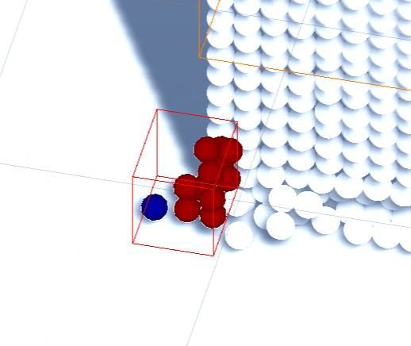
AIM
During the POF project, we were researching ways of enhancing the performance and efficiency of particle-based fluid simulation. Creating a suitable and stable platform for executing a particle-based fluid simulation is one of our primary project goals. This platform is Unity for our project. Constructing a more user-friendly platform for testing and comparing various algorithms for scientific research is another project goal.
We aim to achieve these goals by reaching particles faster by constructing a spatial hash sub-system. To detect surface particles, we must implement surface recognition sub-system.
Our project has no predetermined method because POF is a research and development based. We can research and implement new methods during the project.

Slide 6

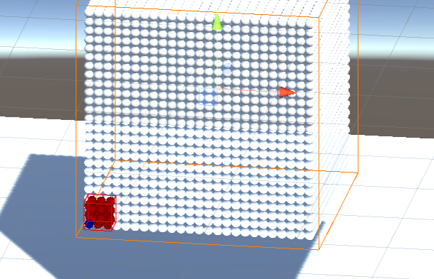
Objectives
The project main objective is making research and implementing the methods in the research papers on particle-based fluid simulations. The implementation of these algorithms consists of two main parts in the POF system: Hash system and surface recognition.
In conclusion, the POF project objective is making research and implement to obtain better performance on finding particles and recognizing surface particles on particle-based fluid simulations.

Slide 7
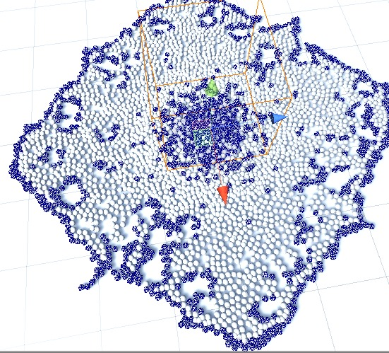
IMPLEMENTATİON
How System Works?
1) Spatial Hash:
Helps us to find particles in 3D.
Access particles faster.
2) Surface Recognition:
Finds the surface particles by calculating the effects of the neighbor of each particle and accepts as a surface particle when the value is smaller than the kernel value accept it as a surface particle.

Slide 8
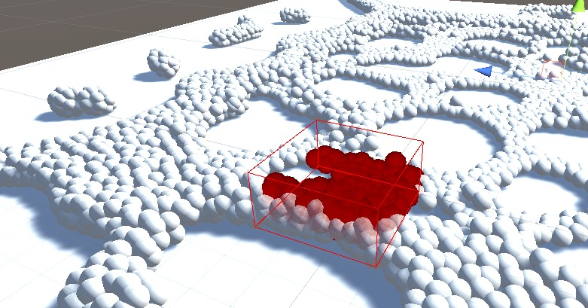
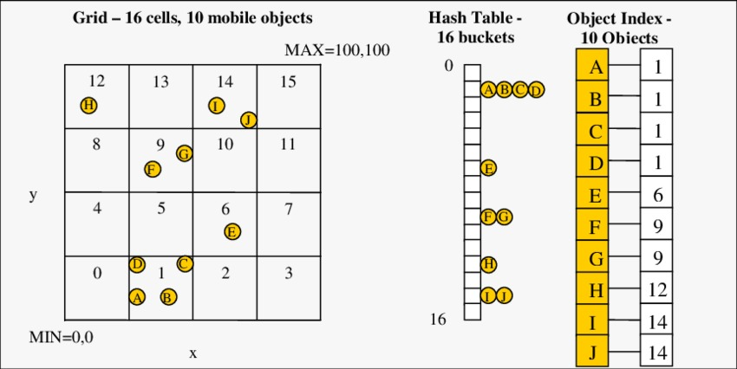
Spatial Hash
What is Spatial Hash?
Spatial hash is a system that allows us to map the position of the particle in a 3D space, and with the spatial hashing algorithm, we converted the position data of the particles into a hash table.
What are the benefits of spatial hash system?
The hash system allows us to quickly access the position of the particles in the 3D space, when we evaluate in terms of performance our surface identification algorithm is based on a particle and its neighboring particles, but when we searched for these particles, we were looking at 4000 particles one by one linearly which causes to the bottleneck of the particle search. Therefore it was inevitable to apply the Spatial hash algorithm and as a result, we obtain execution times between 4 and 6 milliseconds.

Slide 9
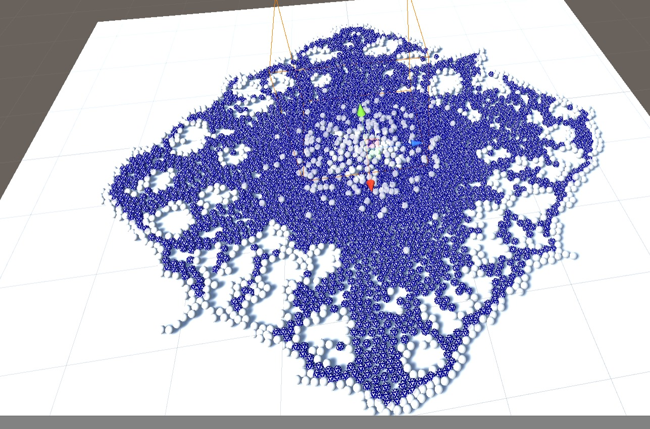
SURFACE RECOGNITION
What is surface?
Surface has a different meaning in our project: The particles that will be rendered in the scene.
The surface recognizer algorithm detects surface particles and their cells so we can discard inactive cells and focus on the surface particles. This method makes the system more efficient and results with better performance by discarding unnecessary cells. The POF system finds each particle.

Slide 10
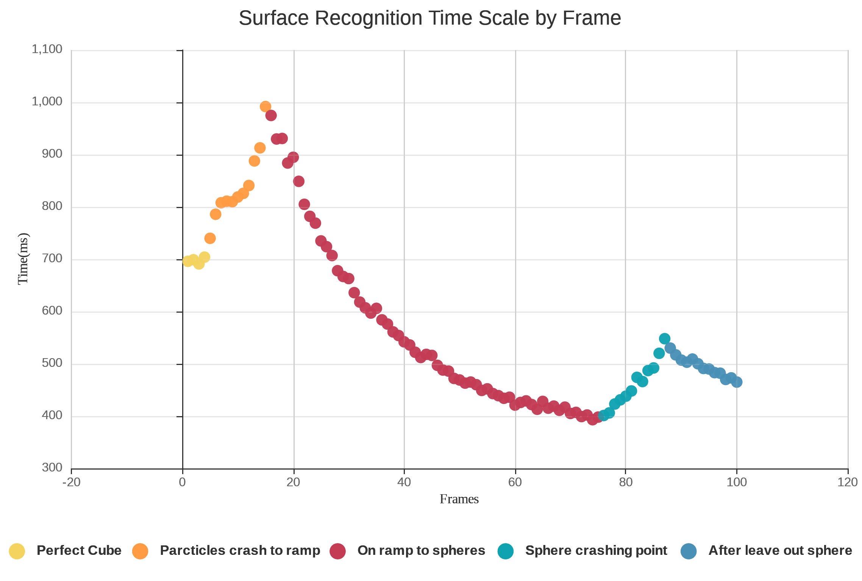
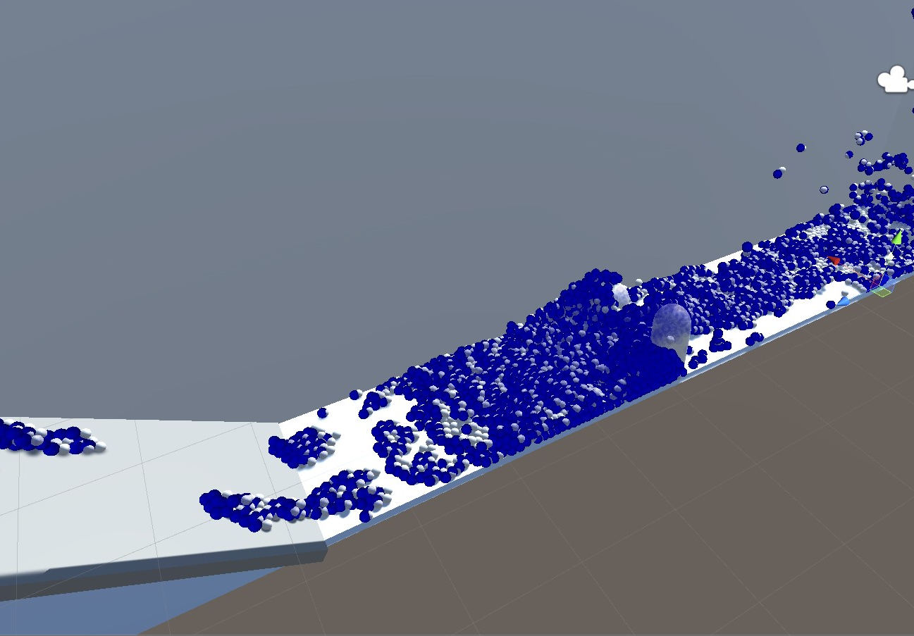
TEST RESULTS 1
The chart shows the first 100 frames of the scene. The chart represents the surface recognition algorithm execution time per frame. Test scene divided into 5 phases. In the chart, the initial execution time is about 700 milliseconds(ms) and increasing when moving on the ramp. When the particles pass the ramp and moves through the sphere and capsule obstacles, complexity is decreasing exponentially. Now of particles collide with obstacles, particle complexity is increasing, and execution take more time. After the particles pass obstacles in the last phase, particle complexity is decreasing, and surface execution is getting faster.

Slide 11
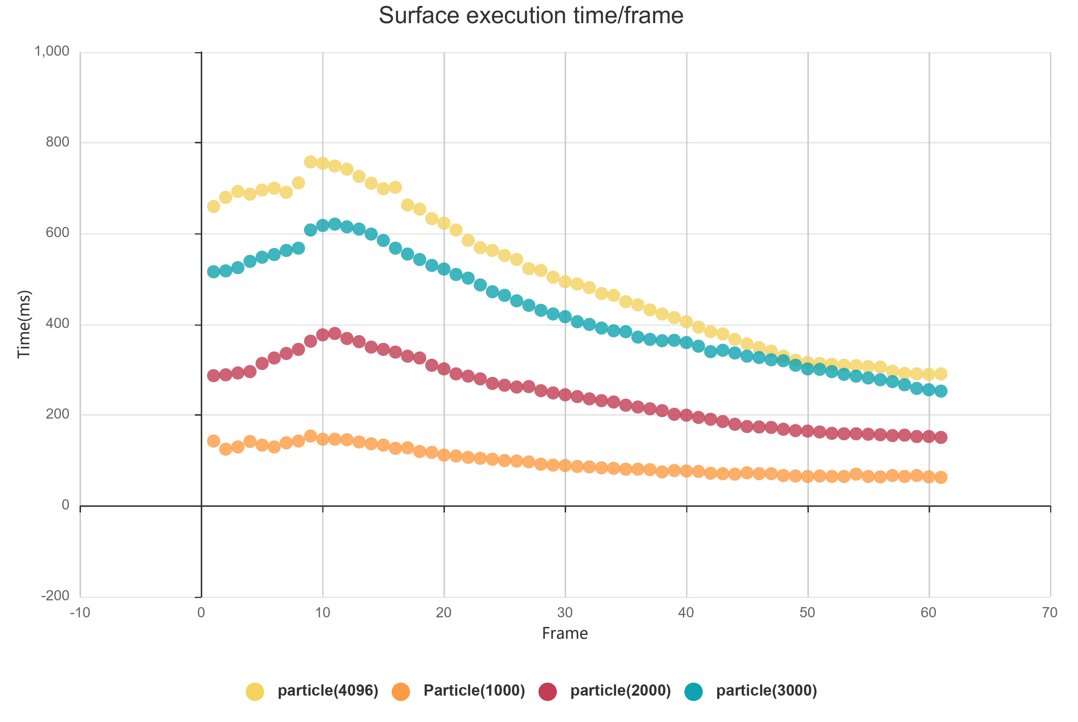
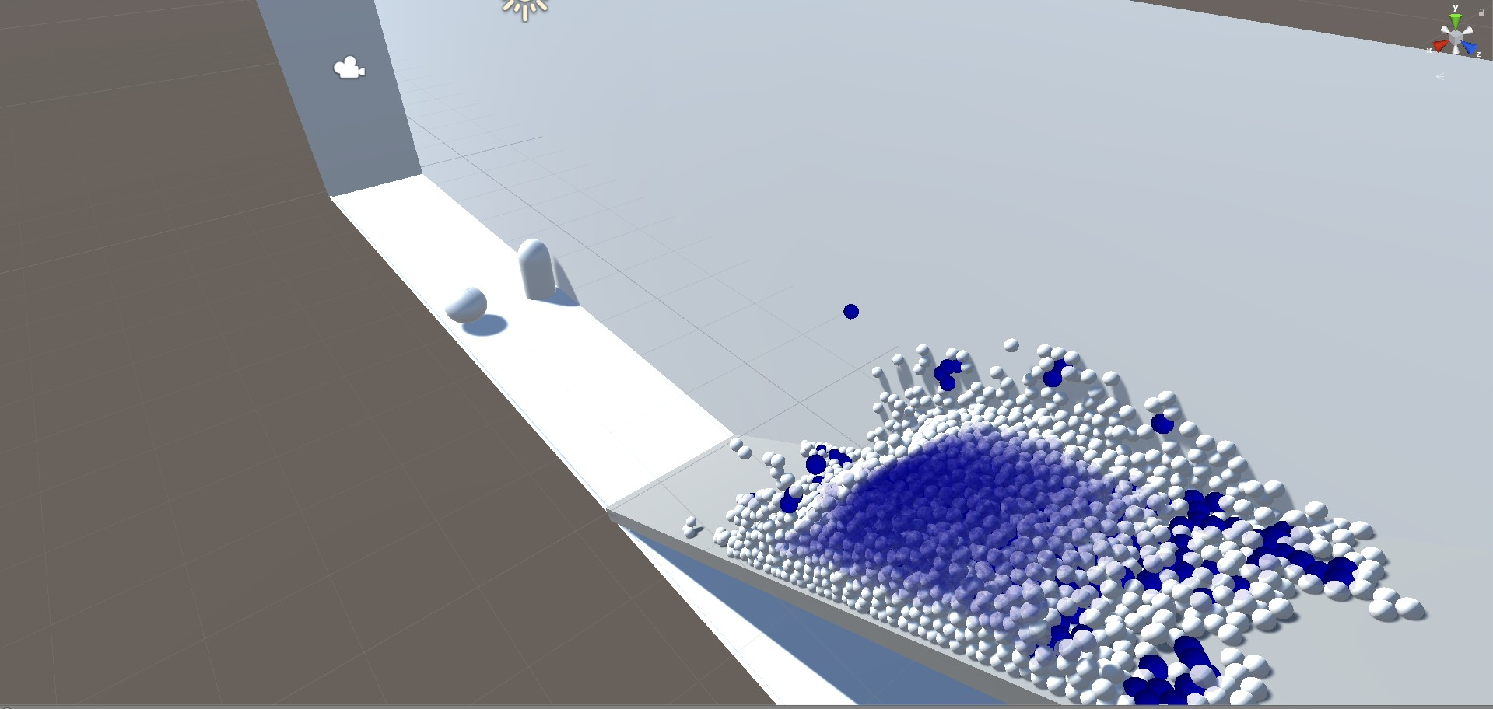
TEST RESULTS 2
We prepared another test measuring scale as particle number. So, we prepared four test cases 1000 particles, 2000 particles, 3000 particles, 4096 particles We decided that measuring the first 60 frames of every particle cases for the testing. Every other variable is the same except for the particle number. The other lines of the different particle numbers are very similar to the yellow line that represents 4096 particles. In this test scene, we measured 60 frames and we did not include particles are colliding to the obstacles phase. The little spike at the right of the first chart is not exist compared. Analyze results of both graphics is complexity drop exponentially.

Slide 12
Conclusion
In our video, we explained what the POF system is. We informed about the project objectives and talked about the hash system and surface identification algorithms of our POF project. In the last part, we discussed the performance tests of the algorithms we applied to our project. POF is applicable for scientific research purposes or animation, film, game and construction fields.

Slide 13

THANK YOU FOR LISTENING ☺
Advisor: Mehmet Ufuk Çağlayan
Baran Budak 15070001012
Cihanser Çalışkan 16070001020
İsmail Mekan 15070001048

